Slide 1
Kinect Wizard Game for Upper Limbs Rehabilitation
Computer Game Engineering
Xuzhe Li

Slide 2
Introduction
General areas about this project:
Gesture recognition
Unity3D
Aims and Objectives:
Building a recognition system
Building a rehab game prototype using the system

Slide 3
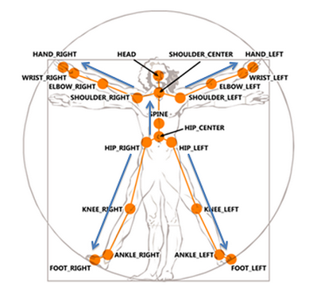
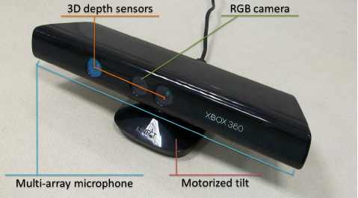
Kinect
Microsoft Kinect sensor

Slide 4
Background and related work
Rule-based approach
Template-matching approach
Hybrid approach

Slide 5
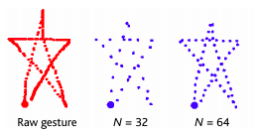
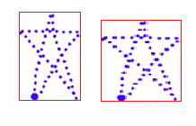
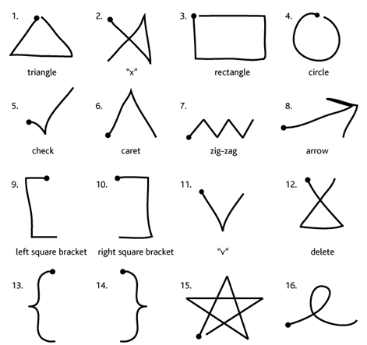
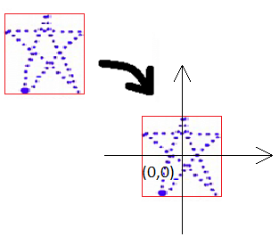
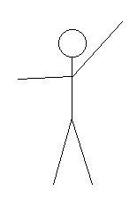
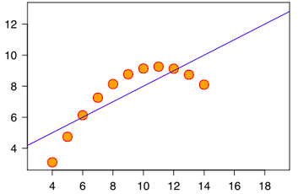
$1 Recognizer
resample
rotate
scale
Recognition
translate
correlation
constraints

Slide 6
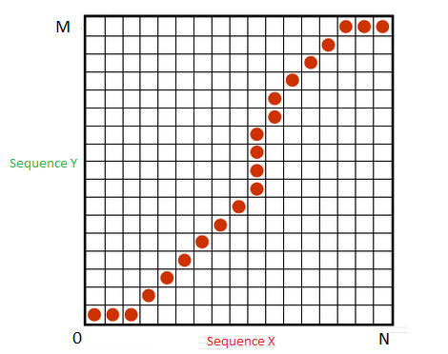
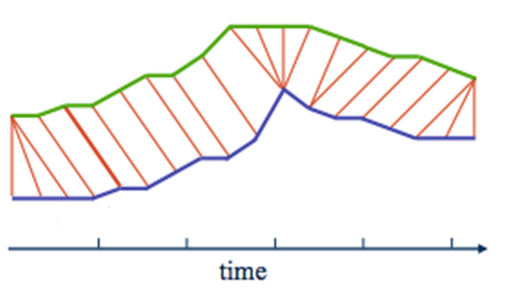

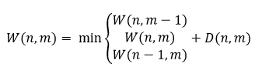
Dynamic Time Warping Algorithm

Slide 7
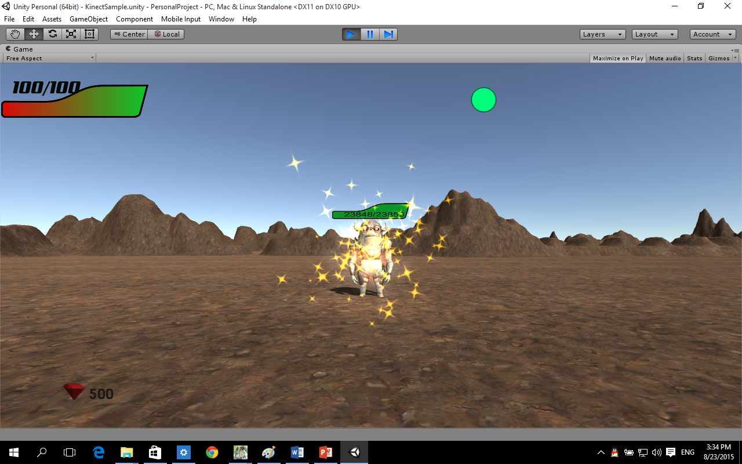
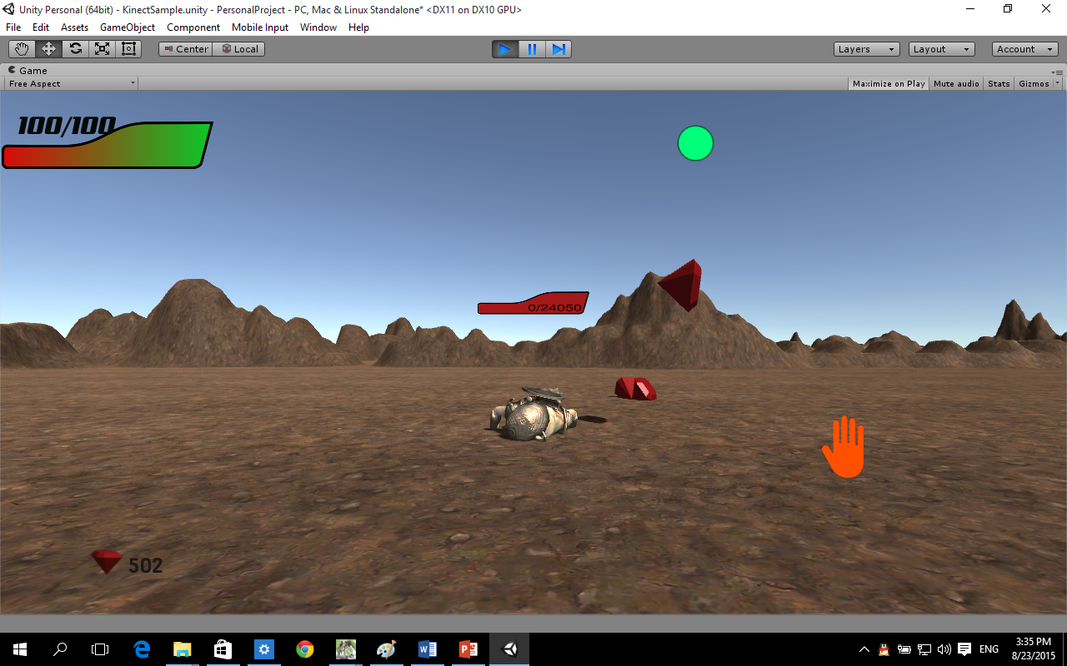
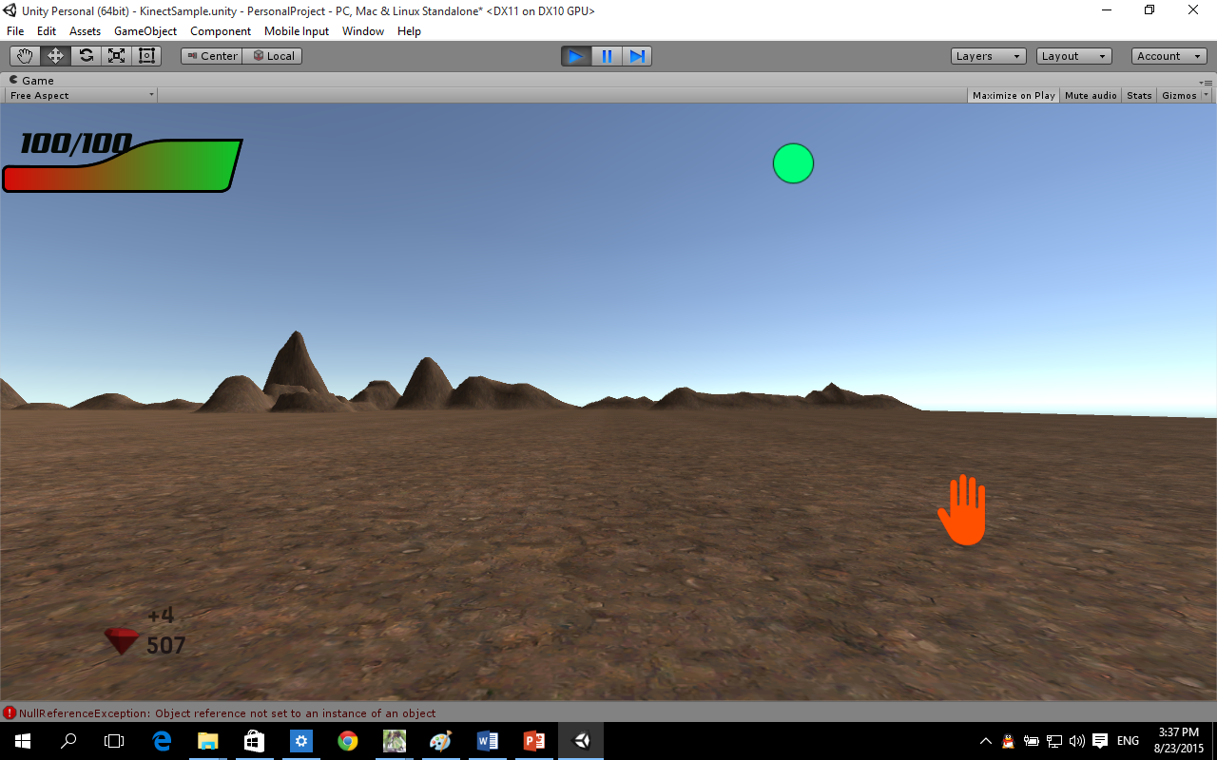
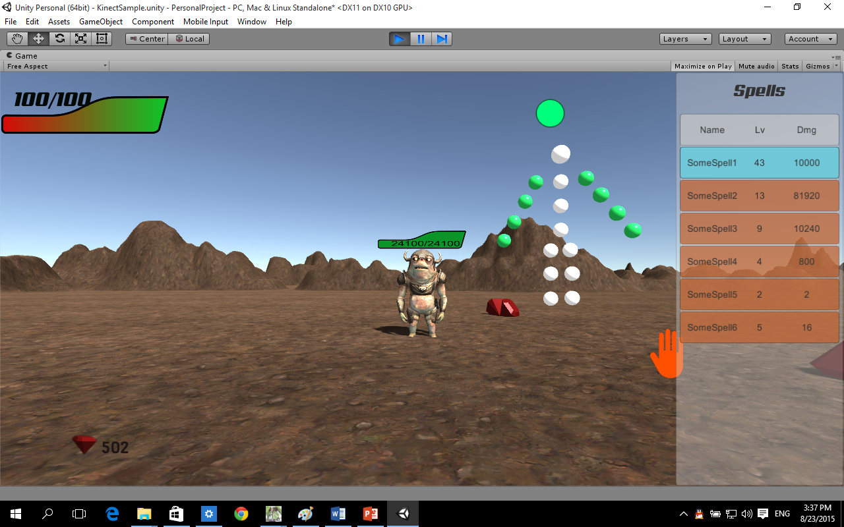
The game

Slide 8
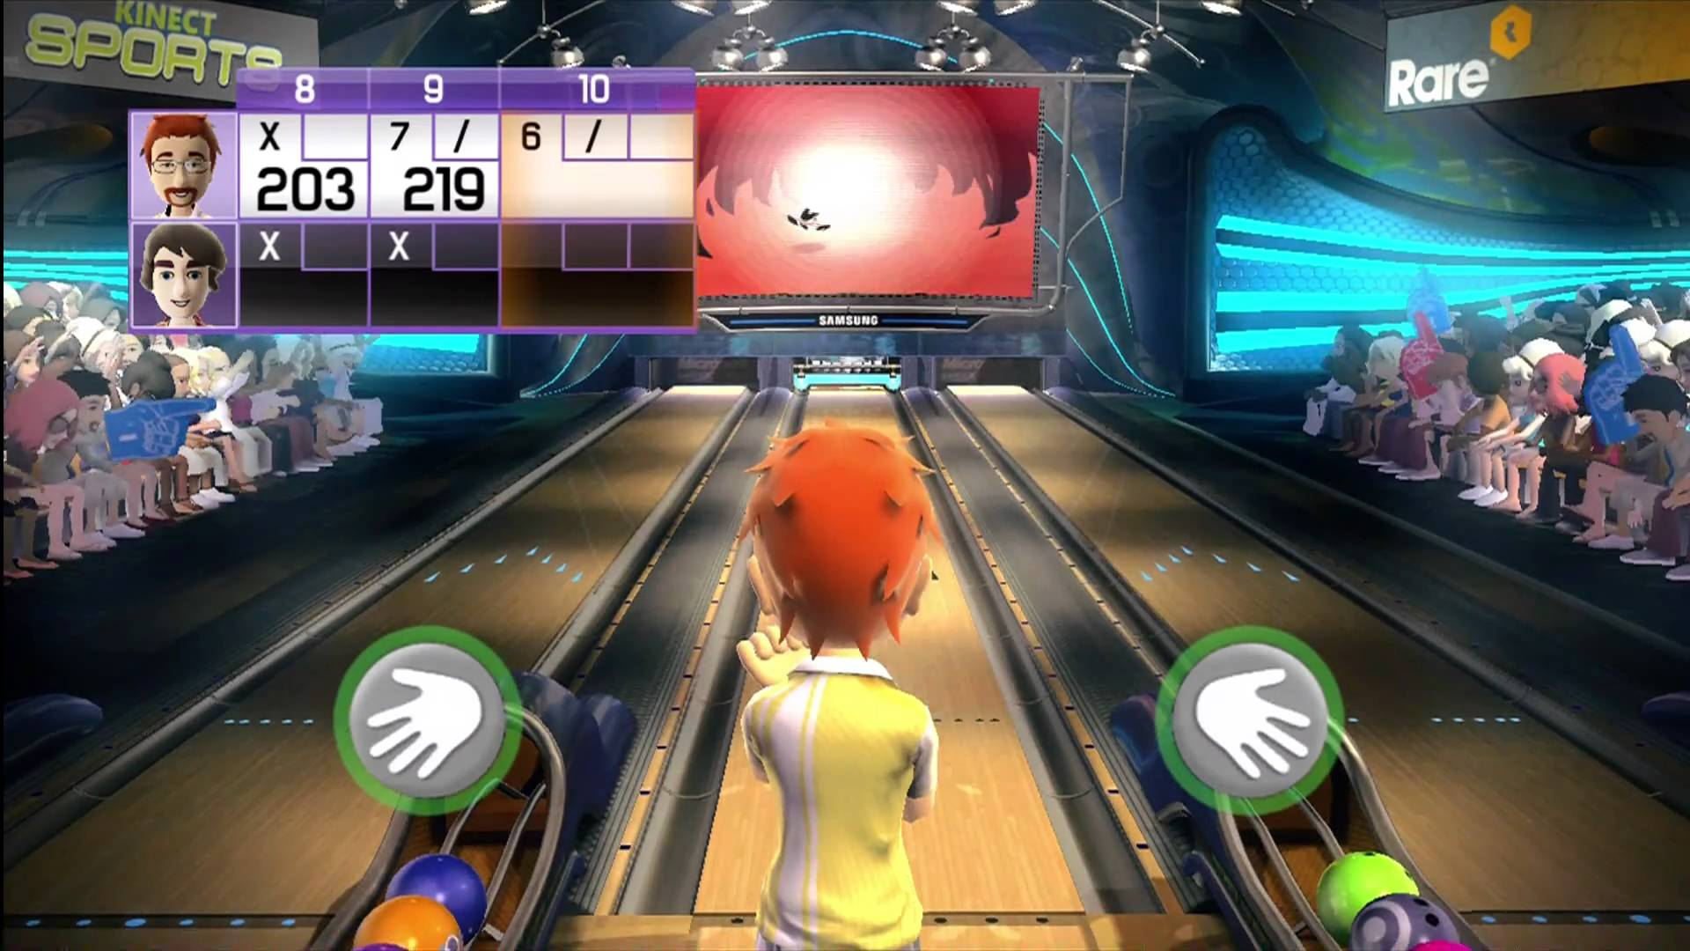
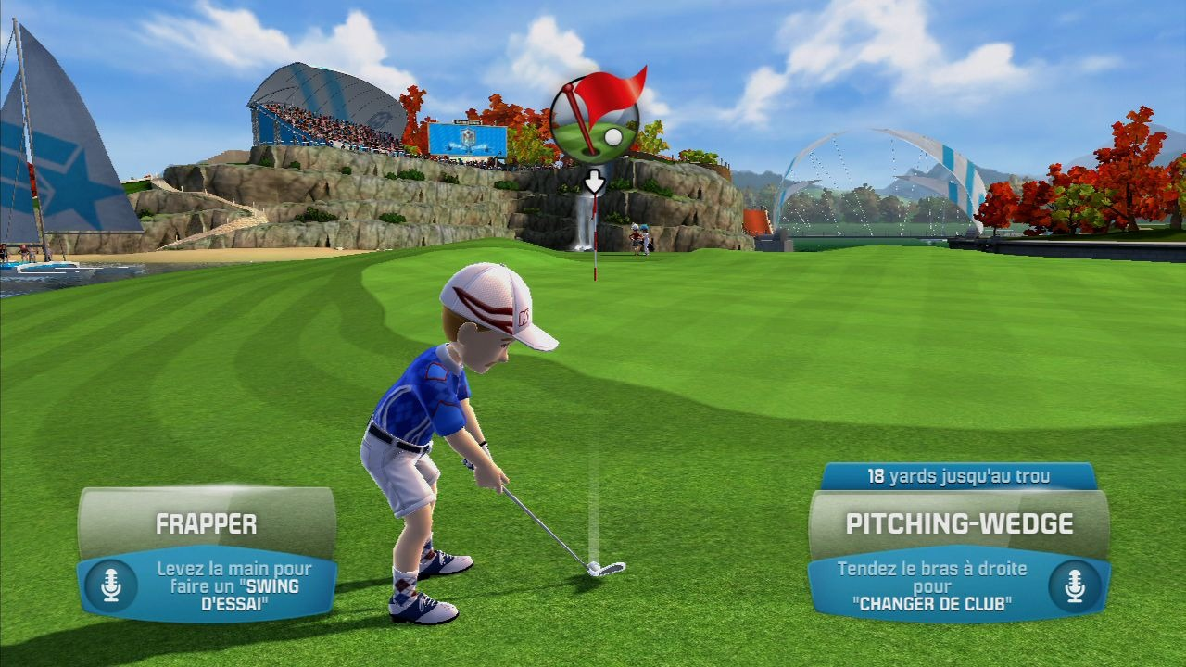
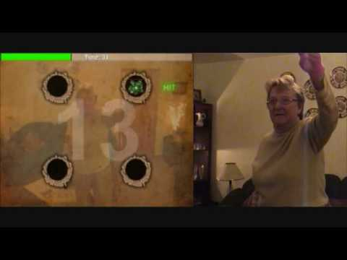
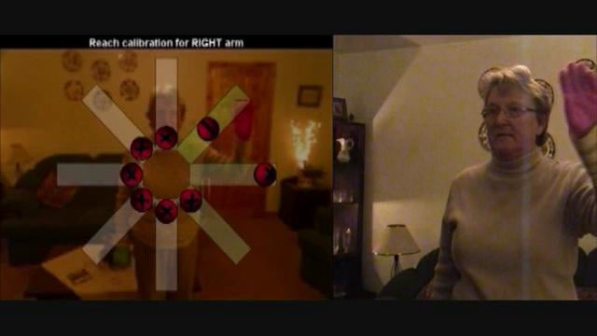
Commercial games
Kinect Sports Bowling and Golf
Simple rehab game

Slide 9
What I have learnt
Familiar with the technologies that are used in the areas of gesture recognition
Kinect application development
Familiar with the develop environment of Unity3D

Slide 10
Thank You!

